Slide 1
Energy Choice: State Policy Considerations
Governor’s Committee on Energy Choice
March 7, 2018
Glen Andersen
NCSL Energy Program Director

Slide 2
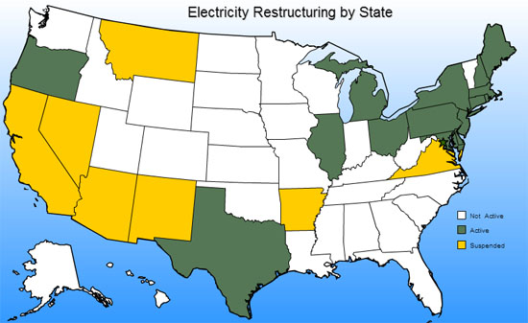
Status of Retail Choice
Source: Energy Information Administration

Slide 3
Illinois
Customer Choice Act (1997)
  Reduced residential rates by approximately 20 percent of 1997 levels and froze them for a decade
  Retail choice was phased in from 1999 to 2002
Amendments between 2006 and 2007
  Offered $1 billion in rate relief
  Created Office of Retail Market Development within the Illinois Commerce Commission
  Allowed municipal corporate authorities to aggregate residential and small commercial retail electric loads in their jurisdiction and solicit bids for service

Slide 4
Illinois
Amendments between 2006 and 2007
  Illinois Power Agency Created in 2007
    Default suppliers (ComEd and Ameren) use the Agency to procure supply on the market. Submit plans to PUC for rate cases.
    Utility assumed payment collection and provided consolidated billing (line charges and supplier bill), then pays supplier. Alternative suppliers can’t turn of service but utility can.
  Implementation completed around 2012, and suppliers entered the market

Slide 5
Illinois
Between 56 and 67 percent of residential customers in Ameren zones have alternate suppliers while the rate is 35 percent in ComEd
2012-14 alternative suppliers were saving $139, but paying $87 more by 2017

Slide 6
Illinois
By 2013, residential switching reached 25 percent
By 2015, 70% residential market in ComEd switched, but decreased to 35% by 2017
Slightly more than half were with municipal aggregators

Slide 7
Texas
Senate Bill 7 (1999)
  Designated a Provider of Last Resort (incumbent utility)
  Requires customers to start with an affiliated retailer – no default service
  T&D provider still regulated
  Established an effective date of January 1, 2002
  Certification process for Retail Electricity Providers
  Established “Price to Beat” for 2002-2007
    Prevents incumbent providers from undercutting new entrants’ prices
    Price floor for incumbents

Slide 8
Texas
Senate Bill 7
  Allowed munis and co-ops to opt into retail choice (just one co-op so far)
  Mandated Energy Efficiency
    Implemented by Transmission Distribution Utilities
    Funded through surcharge on electric bills
    Reduce customers’ energy consumption as well as electric peak demand
    Legislation sets EM&V requirements and goals
  In 2016, 109 retail providers were operating in ERCOT, providing 440 total unique products, 97 of which provided 100% renewable sources

Slide 9
Texas
Texas Power To Choose Website
  Providers will try to game search results and try to create plans that exploit search parameters
  Electricity facts one pager summarizes offer is required to be posted.
  Filters minimum usage fees (legislation to ban them failed)
  Shows providers’ complaint records
  Even with requirements, can be hard to compare plans: i.e. some charge is 1.5 cents per kwh up to 1,000 kwh and 8.8 cents for more than 1,000

Slide 10
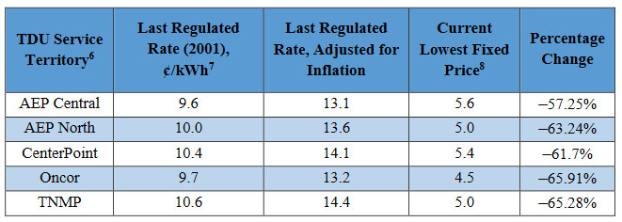
Texas
Rates
  92% of Residential and 98% of non-residential customers have switched providers since the market opened in 2002
  Average across all available plans in the competitive market was 9.8 cents per kWh in 2016
  Fixed and variable rates lower than nationwide average of 13.45 cents
2017 Report to the 85th Texas Legislature: Scope of Competition in Electric Markets in Texas

Slide 11
Pennsylvania
Electricity Generation Customer Choice and Competition Act (1996)
  Legislature worked in close collaboration with the PUC in drafting legislation
  Default Service Provider – regulated and must pass through cost of generation – can’t lowball or overcharge
  Rate caps were removed by 2011, retailers started entering the market in 2010
  One year pilot phase-in period for 5% of customer base to identify and sort out challenges
Legislation to require choosing a retail provider failed in 2013 after polar vortex rate spikes

Slide 12
Pennsylvania
Key Reforms
  Quick Switching – allow customers to quickly switch back to default provider—within 3 days in PA
  Marketing regulations – required suppliers to verify enrollment through 3rd party to minimize slamming
  Disclosure regulations – craft rules that help customer navigate new offerings but don’t hinder innovation
  Electronic Data Exchange Working Group – data exchange between utilities and suppliers is key to a functioning market

Slide 13
Pennsylvania
Outcomes
  Between 1996 and 2011, rate caps were removed in individual utility regions one after another
  Switching rates from January 2018
    Residential 33%
    Commercial 85%
    Industrial 97%
  Low Income
    Support of EE for lower incomes
    Bills capped to percentage of income
    70% of the low income customers who switched from default service paid more (Kleinman Center for Energy Policy - University of PA)

Slide 14
Pennsylvania
Rate Impacts
  From 2011 to 2014, Commercial and Industrial rates generally lower than default service rates
    5 to 56% lower than 1996
  Residential rate generally higher
    2 to 41% lower than in 1996
  Distribution prices
    Down for commercial and industrial sector
    Up for residential sector
https://kleinmanenergy.upenn.edu/paper/electricity-competition

Slide 15
Montana
Montana Electric Utility Industry Restructuring and Consumer Choice Act (1997)
  California crisis introduced major volatility into the market
  Couldn’t insulate itself from regional market fluctuations
  Price caps expired after 2003
State responded by passing nine bills in 2001
  Waived taxes and other incentives for new generation in the state
  Voters rejected major bill to save the industry in a 2002 referendum, which ended restructuring efforts
Reregulated in 2007 with the Electric Utility Reintegration Act

Slide 16
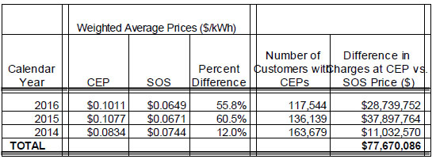
Rate Impacts in Other States
The Maine Public Utilities Commission found that, from 2014 to 2016, competitive electricity provider customers paid $77.7 million more than what they would have paid for standard offer service
In January 2013, New York‘s attorney general found that 91.5 percent of upstate low-income consumers who’d switched were paying higher rates than if they’d stuck with the default provider utility

Slide 17
Issue to Consider
Providing an accurate, informative, and fair presentation of offers; setting parameters
  Ensuring customers can easily distinguish differences in cost, services and benefits
  Balance tension between distorting market and provide enough information, but not too much
  Requirements for all electricity companies to advertise their plans with the same pricing details (kwh charges plus T&D)
  Minimum usage rates discourage conservation, hurt low-income consumers and increase T&D costs; effect energy efficiency
  Address minimum fees, low intro rates, early termination charges, contract length, and other details
  PA website requires all disclosures and 1 page contract summary while new rulemaking addresses introductory pricing

Slide 18
Issue to Consider
Switching
  Ensure customers receive clear signals when switching
    In Texas, ERCOT sends postcard notice before switching
    In Pennsylvania, third party verification of switching
  Provide significant penalties for slamming and cramming
  Set switch hold policy
Reporting
  Biennial report to legislature in TX: Scope of Competition in Electric Markets
  No reporting required in PA
  Legislative reports required in IL

Slide 19
Conclusion
“Restructuring of the electric utility industry is not for the impatient, the weak-kneed, or the fainthearted.”
- Montana Electrical Utility Industry Restructuring Transition Advisory Committee Report to the Governor and Legislature, December 2002.

Slide 20
Contact Information
Glen Andersen,
Energy Program Director
Phone: 303-856-1341
glen.andersen@ncsl.org
Additional Resources
NCSL Energy and Environment Database
NCSL Energy Program

